Slide 1
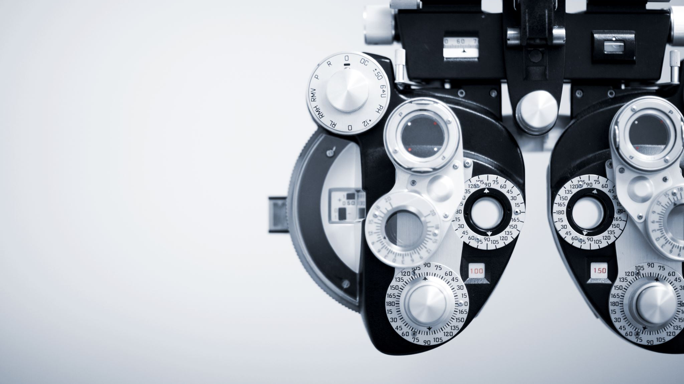
Vision Space
MInD Lab Translators New Project T2 - 2021
Presented By Bryan Hew - T2 - 2021
Notes:
Hello Everyone, My name is Bryan Hew here introducing MInD Lab Translators newest Project.
Vision Space

Slide 2
Project Vision
To use both Virtual reality and Mobile Applications that allow designers to visualise the way people move and interact within a 3D environment
By analysing movement within a given environment, Designers are able to better design or change design concepts based on user activity and interaction within a given environment
Notes:
The Project vision is to be able to use both Virtual reality and Mobile applications that allow designers to understand and visualise the way people move and interact within a given 3D Environment
By analysing movement within a given environment, Designers are able to better design or alter design concepts based on the user activity and interaction within a given environment

Slide 3




Vision Space Overview
Using eye tracking technologies, display how a 3D space is traversed/viewed by its users​
To Develop a mobile application which works off the collected data to produce visuals to assist designers on how people interact within an environment space​
Notes:
The project can be split up into two different parts.
First up is to use eye tracking technologies to display how a 3D space is traversed or viewed by its users.
Secondly To develop a mobile application which works off the collected data to produce visuals to assist designers on how a environment is traversed or interacted with.

Slide 4

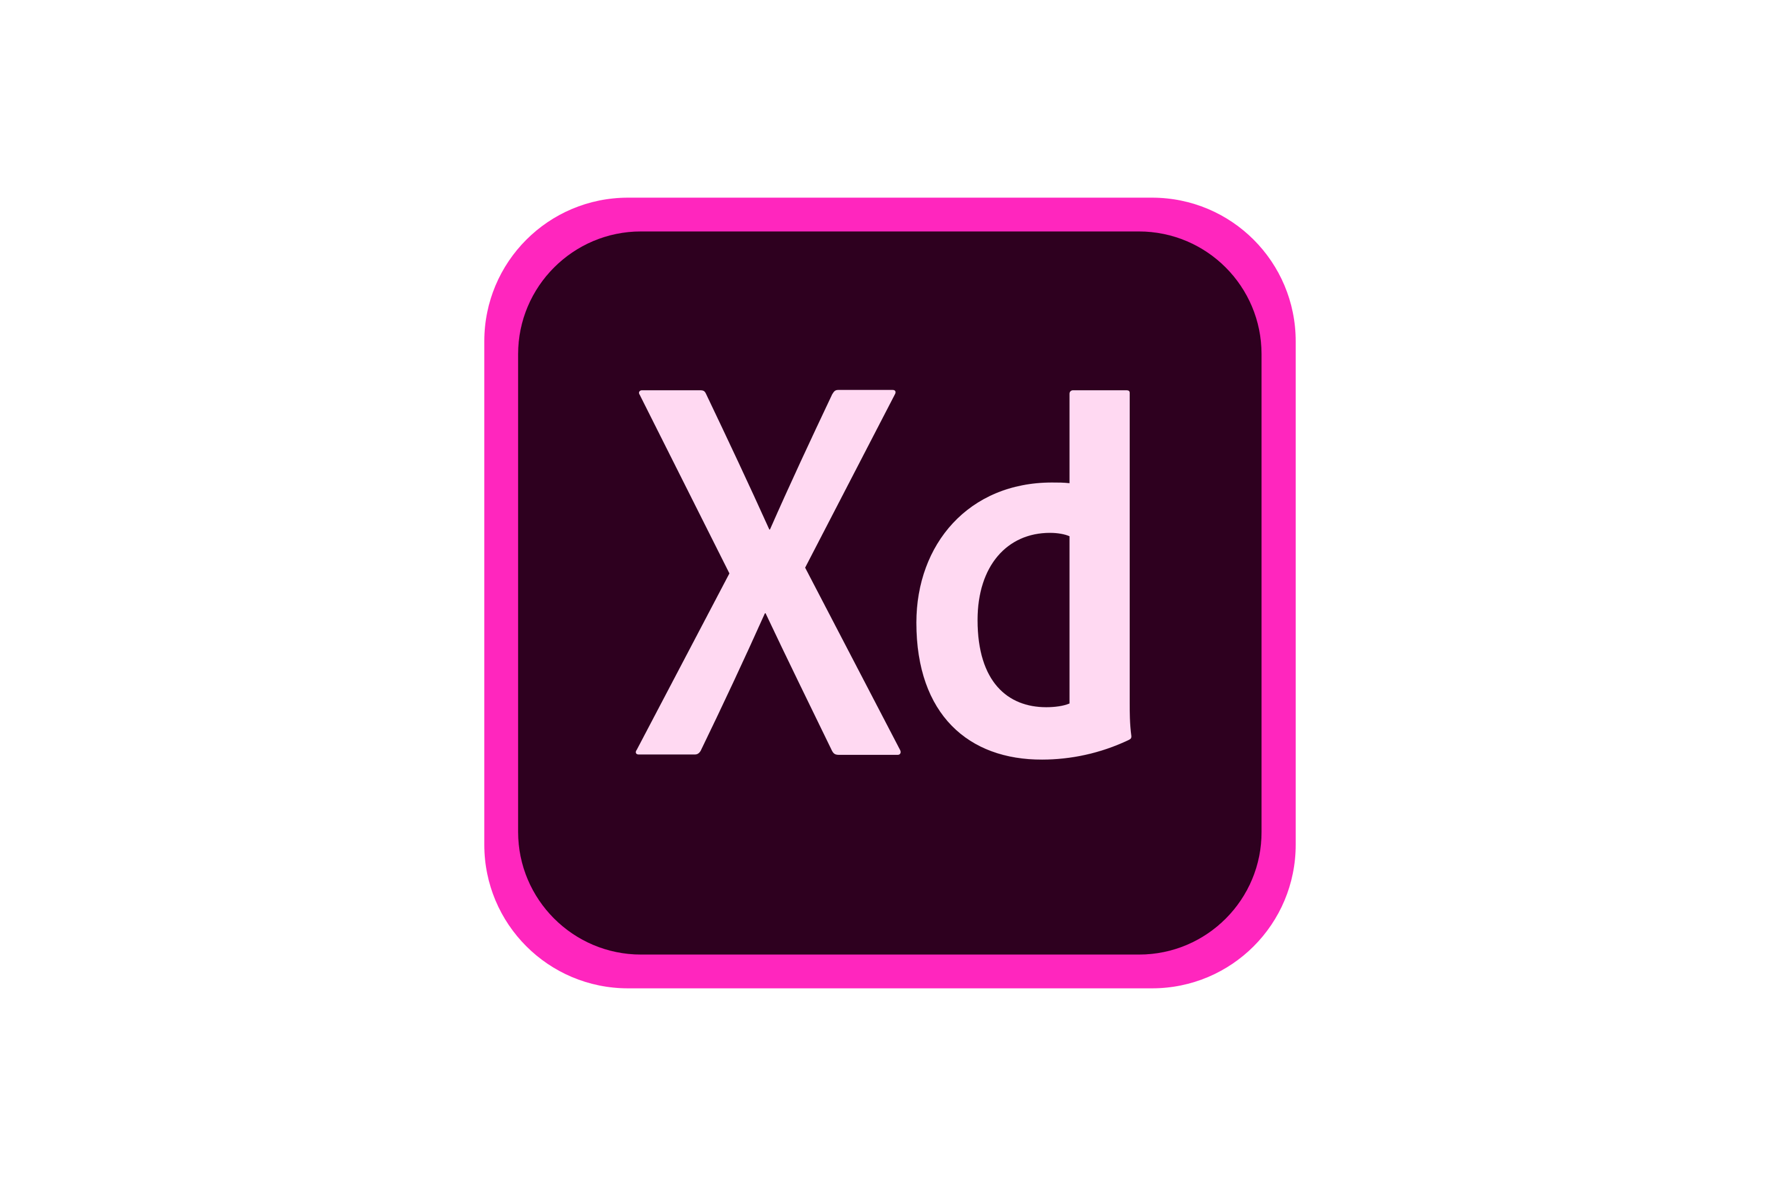

Technology Stack
Android Studio
Adobe XD
Google Firebase (Database)
Notes:
Our Technology Stack currently includes
Android Studio, which is our application development environment currently coded in the java mark up language
Adobe XD, is our design and mock up space
Lastly google Firebase is our Database of choice

Slide 5
Trimester Focus: Mobile Application Planning and Design
Notes:
Our main focus of this Trimester was on the Project planning and Mobile application Design.

Slide 6
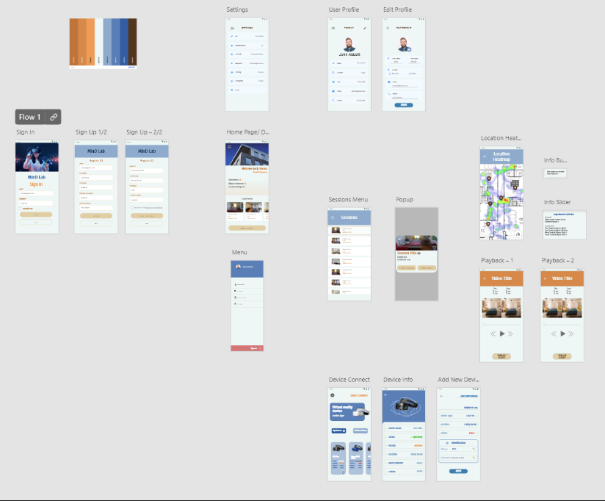
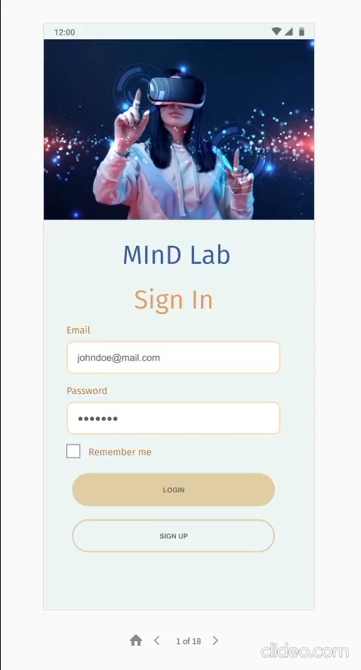
Mobile Application Mockups (Adobe XD)
Adobe XD Mock-ups
Notes:
This is the Mobile application’s design mock-ups created by the Design Team
On the left, there is a quick video on the flow of the application
The right side image shows the designs of the created pages all created on Adobe XD

Slide 7
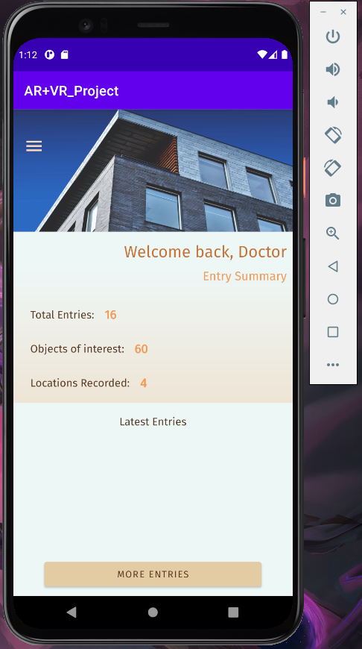
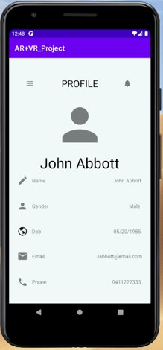
Mobile Application Implemented Pages
Sign in / Sign up
Dashboard
Profile Page
Notes:
Throughout the Trimester the Squad has worked on these following pages in Android Studio
The sign in / sign up
Dashboard and Profile Page

Slide 8
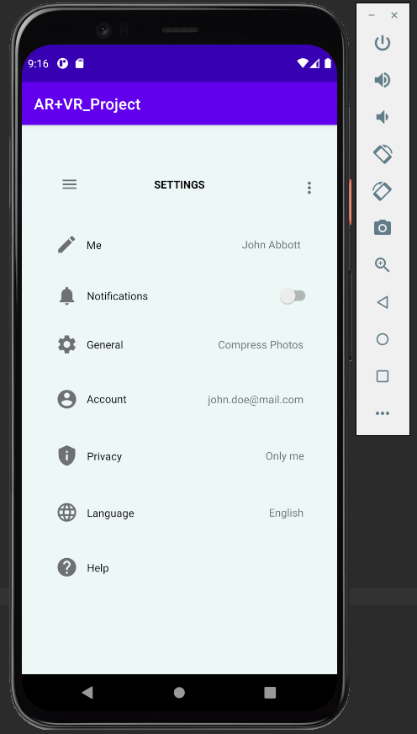
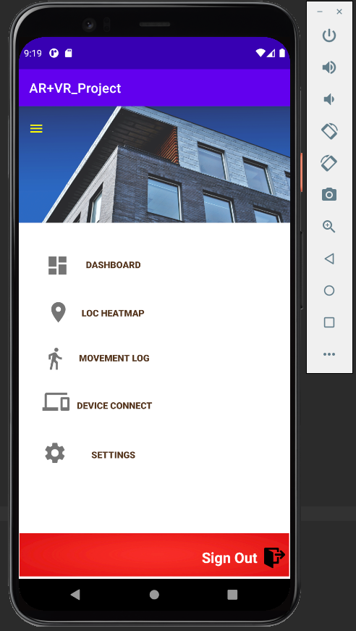

Mobile Application Implemented Pages
Settings Page
Menu page version 1
Menu Overlay version 2
Notes:
Settings page
Menu pages,
The original concept was to have a separate Menu page, but after much consideration, Design team decided that the app would do better with a Menu Overlay which slides above the current page.

Slide 9
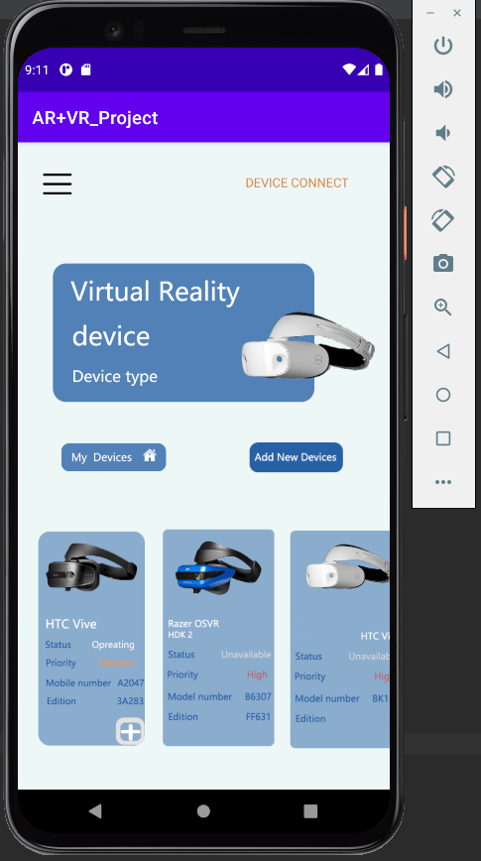
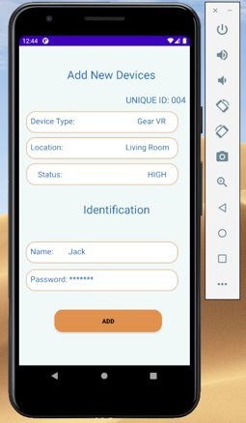
External Device Pages
My Device
Add Device
Notes:
These two pages, are for the external devices which may be connected with each account.
An example here is that the user can add what device they used to record that data with. And it will be shown in their account.

Slide 10
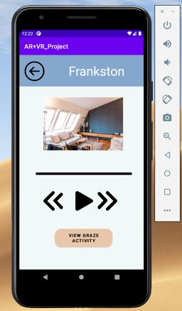
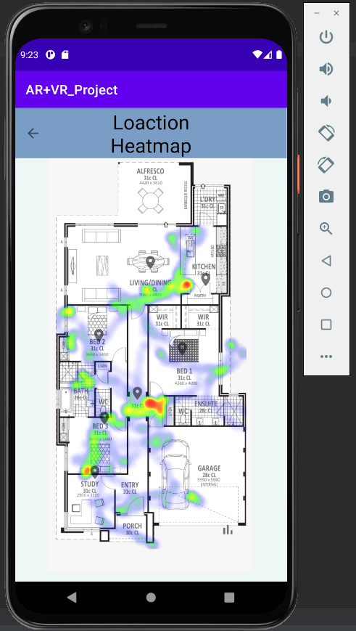
Data Usages
(Current images used to act as place holders at the current moment)
Session Selection
Session Playback
Location Heatmap
(Using phone data)
Notes:
Here we have the Session Selection which allows the user to select a session that has been recorded and then allows them to replay that footage in the session playback
Location Heatmap is a concept idea where we want to display user traversal in the application

Slide 11
Future of the Application
Linking the menu buttons to actual pages – for application navigation (Slide out menu)
Data Validation – (Checking that user has made account or account is saved in database)
Data Conversion into Readable Graphs
Research how to connect / transfer data from VR platform to mobile application
Creating application functionality
Researching Virtual Reality and Eye tracking Data collection methods
Possible Expansion to Augmented Reality
Notes:
The Future of Vision Space

Slide 12

Thanks For Watching!

